Slide 1

DriverPass System Analysis
Nathan deBar
Notes:
[No speaker notes required for this slide.]

Slide 2

System Requirements
Function Requirements:
DriverPass shall utilize an online learning format.
DriverPass shall have an appointment-based system and can be monitored through generated reporting.
Non-Functional Requirements:
DriverPass system will utilize a case sensitive criteria for usernames and passwords to ensure users can be identified from one another.
DriverPass system must connect to the local DMV to ensure policies remain up to date in all relevant course materials.
Notes:
Within the functional requirements I stipulated two key points. Firstly, the system must operate via an LMS that will allow course material to be distributed accordingly to users. This will ensure that users have full and consistent access to their related content such as tests, quizzes, and other pertinent information. Secondly, this system will also tie into the scheduling software so that users can track the date, time, and notes for each in person driving appointment. This LMS will also allow for the generation of activity reporting to validate system use and track individual user activity for both students and employees. The nonfunction requirements are as follows: The system must be able to distinguish individual users through unique login information. This has been done by ensuring usernames and passwords are both case sensitive. This allows for the system to identify user roles and permit them the relevant access to be successful. Additionally, for the system to operate successfully it is imperative that the DriverPass system is linked to the local DMV and kept up to date on relevant policy changes. This allows the LMS to offer the best information to its users and provide instructors with the tools required to ensure student success.

Slide 3
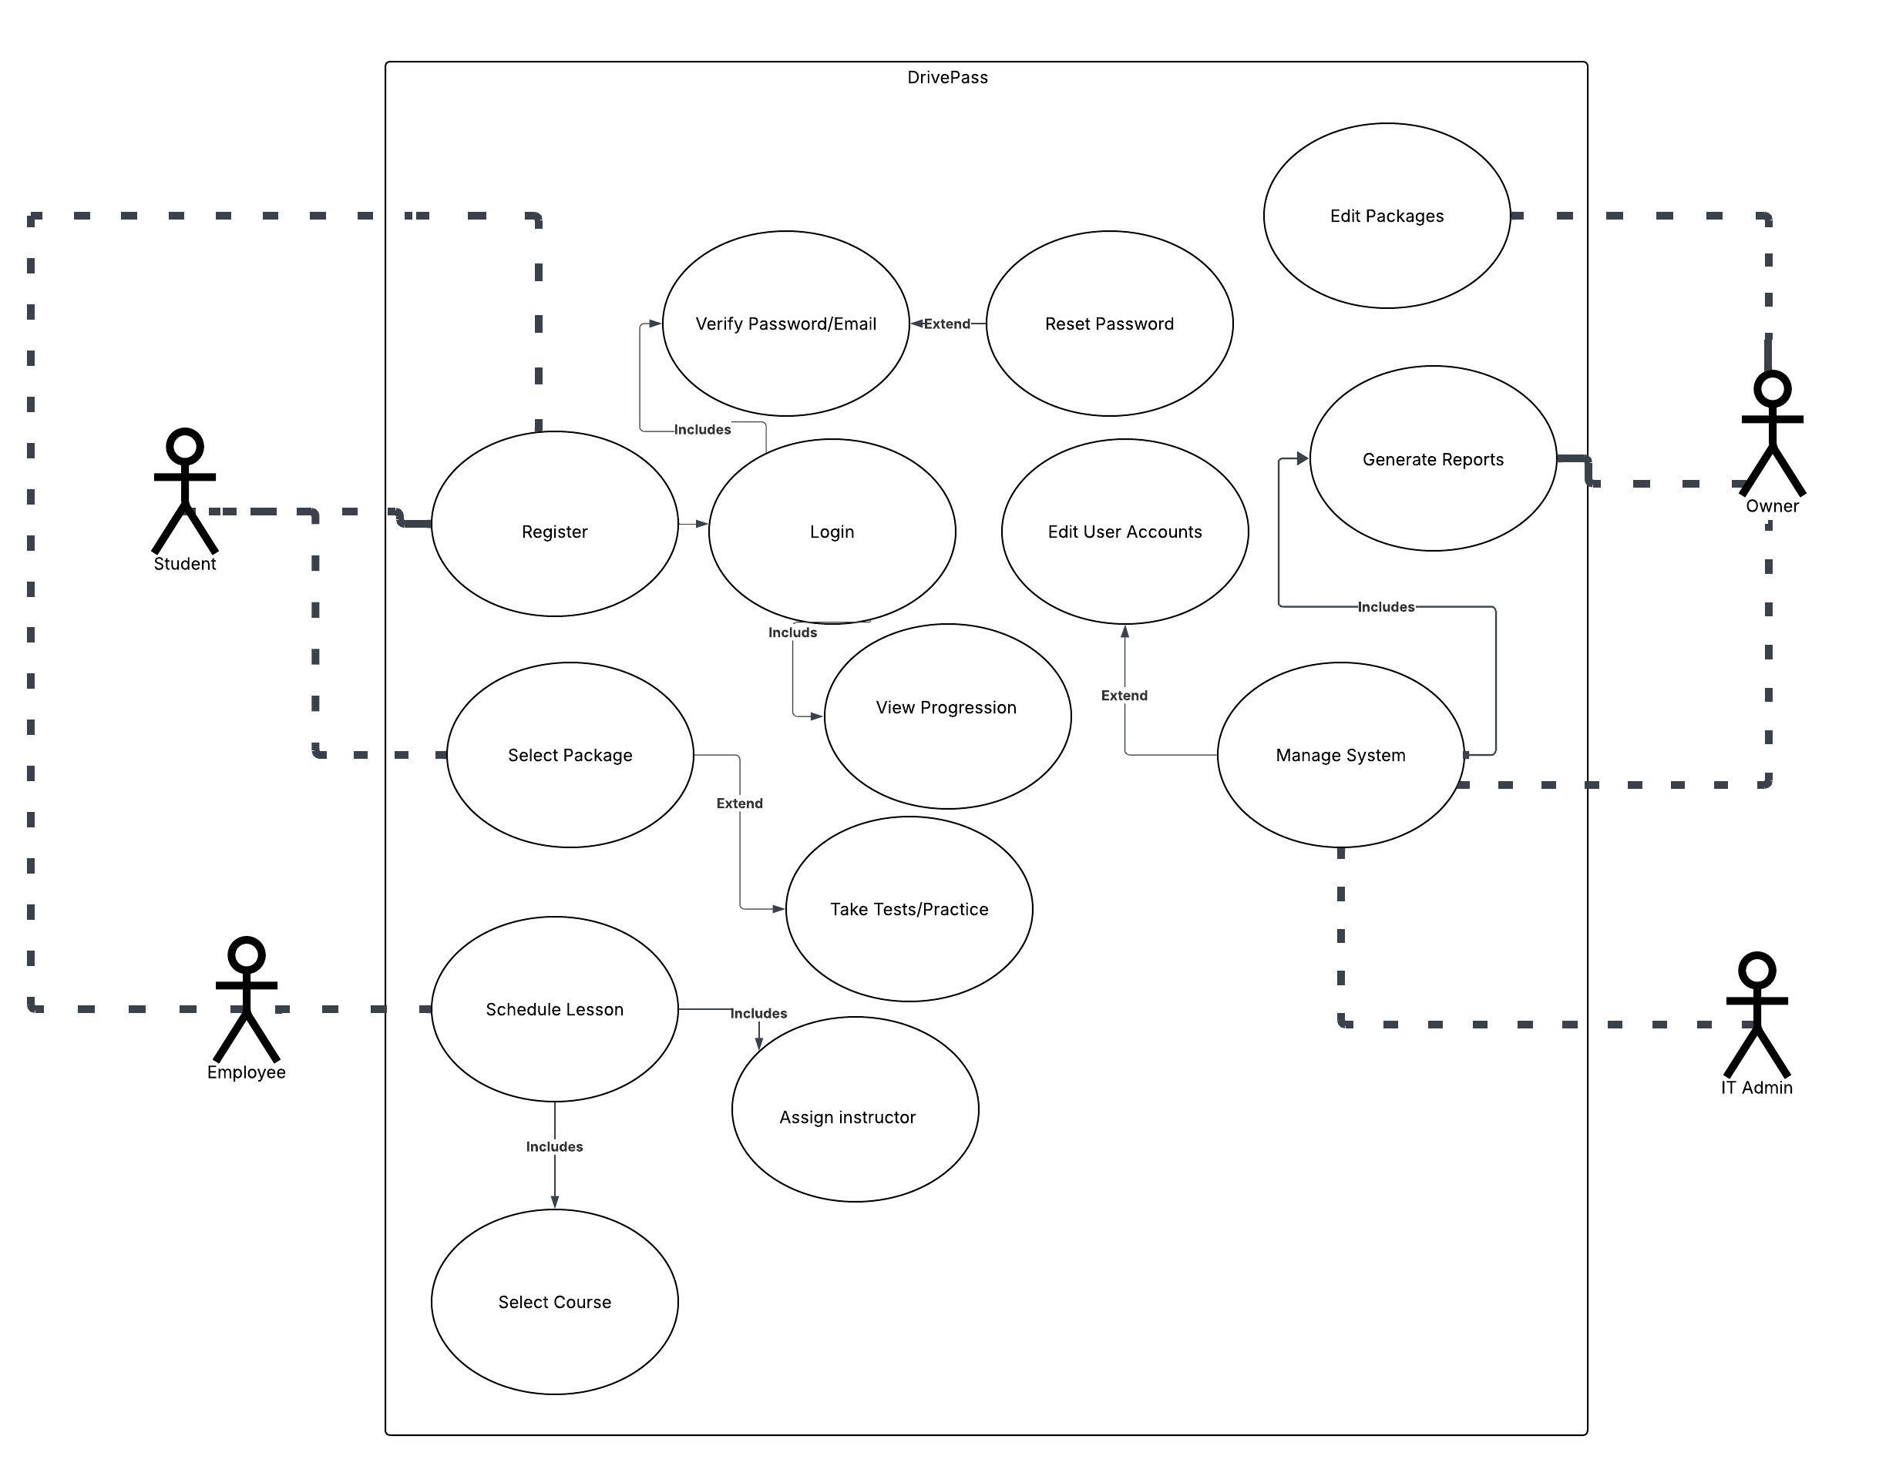
Use Case Diagram
[Insert your use case diagram here.]
Notes:
This use case diagram describes how each role will interact with the system. The main actors within the system will be the students, employees, IT Admin, and the Owner. The Student will be able to register for courses, select package options, login, track progress, complete course material, and verify/reset login information. The Employees will similarly be able to schedule lessors, select relevant courses, and assign instructors to students for in person driving. The IT Admin is responsible for the overall management of the system such as ensuring it is up to date, users have proper privledges, as well as editing or modifying the main system. The owner will be able to monitor activity across the system and generate reports accordingly. He will also be able to edit, add, or cancel packages respectively.

Slide 4
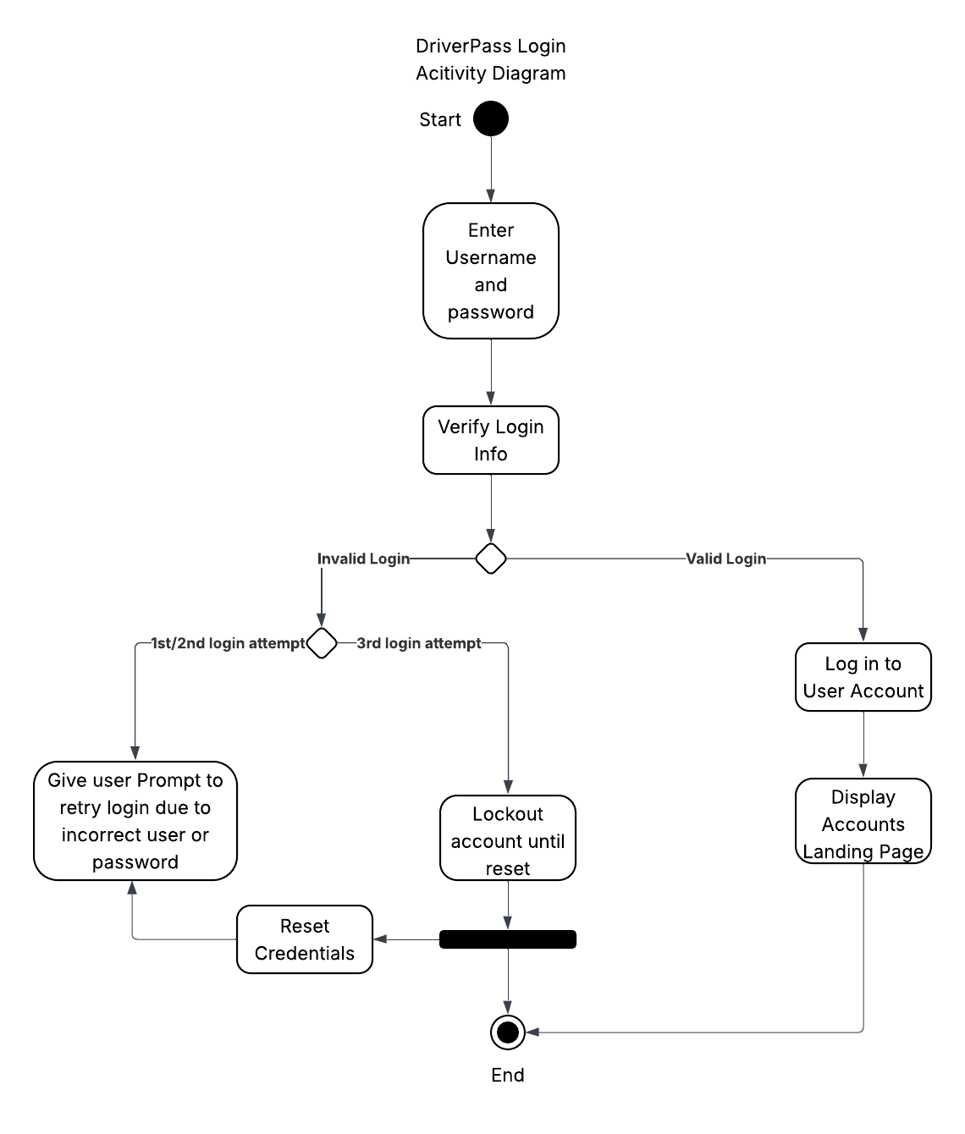
Activity Diagram
[Insert one of your activity diagrams here.]
Notes:
For the follow use case I will show a breakdown of how the login sequence will be executed. It starts when a user enters their username and password. This information is then passed to the system for validation to ensure that it is correct. If it is then it logs the user in and displays their account landing page. If the information is incorrect the user will have 3 total chances to enter the correct information before they are locked out and have to reset the relevant credentials. For each failure the user will be prompted to try again as their login failed due to incorrect login information.

Slide 5
Security
Logins are uniquely created by the users, assigned within the system, and will have the proper role associated with them.
This login is case sensitive to allow for a stronger unique ID.
Full access to the account system will only be given to the Owner with the ability to reset user passwords, or lockout accounts entirely.
The system will have inherent account security built in to prevent brute forcing of accounts by locking out accounts after the third failed attempt.
Notes:
The systems security is built around unique login IDs. This information is associated with designated user role level which allows them to utilize different features of the system relevant to their role. The logins are protected by a case sensitive username and password as well as an attempt limiter to prevent others for forcing their way into the system. It is the IT Admins responsibility to maintain system health by keeping it up to date with security standards.

Slide 6
System Limitations
Development timeline is a 5 month minimum
Requires interconnection with DMV databases
Budget has not been specified
Notes:
We have produced a five-month development lifespan that will begin January 22nd. The development stretch will be completed with a signoff meeting on the system that will take place on May 9-10. The system must be integrated with the DMV to ensure that information remains up to date for local policies. This may lead to complications due to the amount of differing areas with DMV regulations. Given the scope of the project and that DriverPass may look to expand their application later so it is best to try and keep costs of the project down.

